Slide 1
Aspiring Minds – Round 2
YokaMurugan k
Git Repo:

Slide 2


Q-1 Proof of Concept to demonstrate an application designed using Dependency Injection design pattern. Expected the architecture and an implementation approach with a sample project
Technology Stack

Slide 3
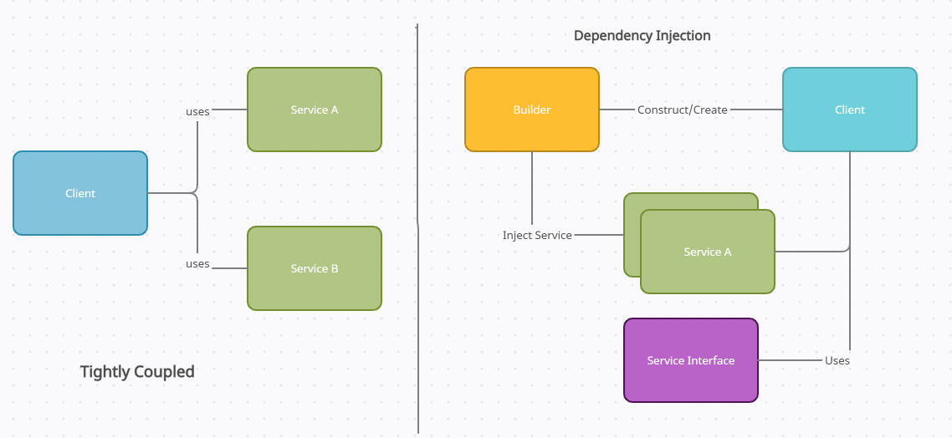

Slide 4




Q2 -Create a Progressive Web App that allows readers to keep up with all topics, news, and events they care about, from one single place. The platform should bring news and stories from around the world together in a magazine format.
Technology Stack
ROME

Slide 5
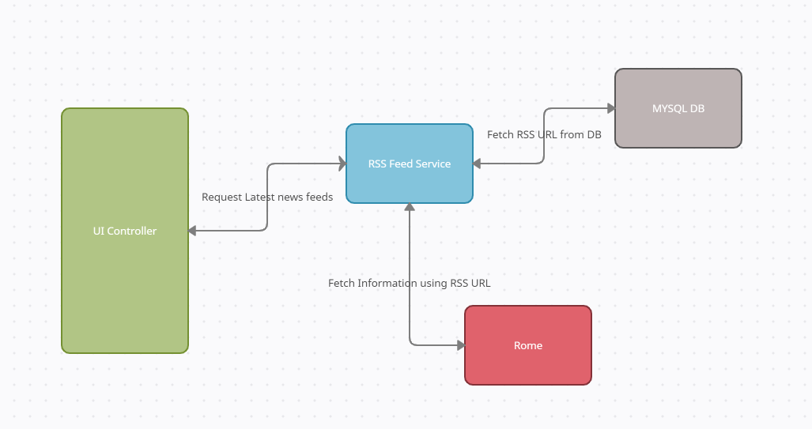
Application Framework

Slide 6
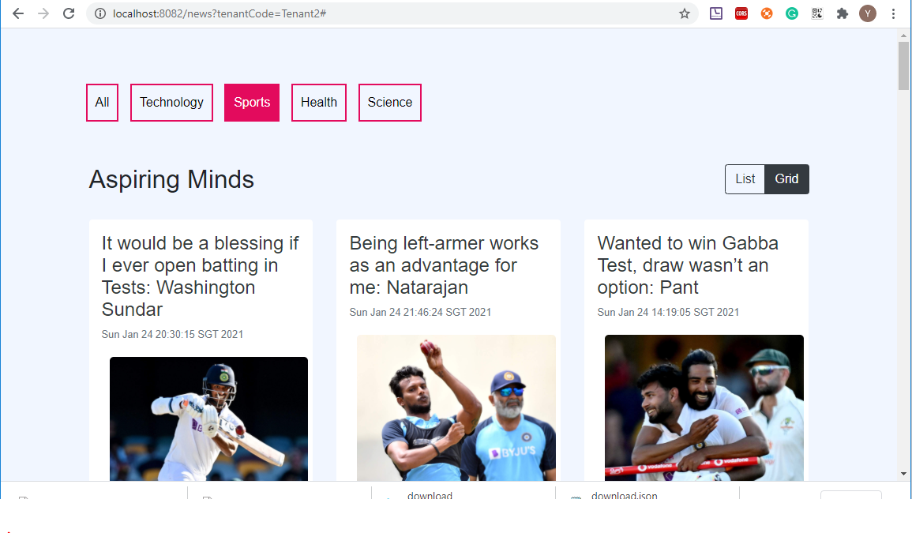
POC Screenshots

Slide 7

Q3 -Design an Architecture and a proof of concept development which can be used for searching the resume bank (repository can be file system, database etc) where based on the keywords given resumes can be picked with top to bottom relevancy or occurrence. Solution can also include any open source algorithm or framework. When there is a Job Description comes and a set of keyword entered the system shall go and check the prediction on how many resume matches we have in the resume bank
Technology Stack
GATE
ANNIE

Slide 8
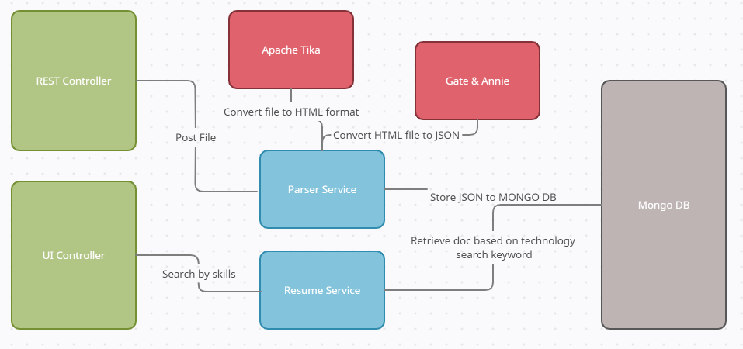
Application Framework

Slide 9
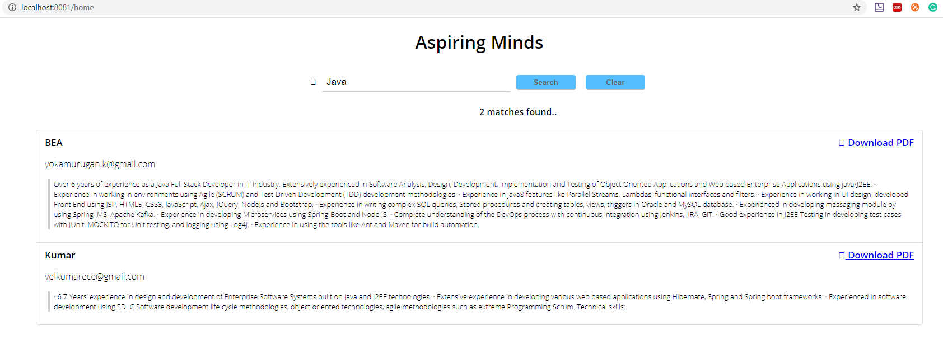
POC Screenshots

Slide 10
Q-4 Solution to handle broadcasting and receiving the data in a socket within the application, also when it goes to other application solution to encrypt and decrypt the data both “At Transit” and “At Rest”. A sample proof of concept implementing this solution is expected.
Technology Stack

Slide 11
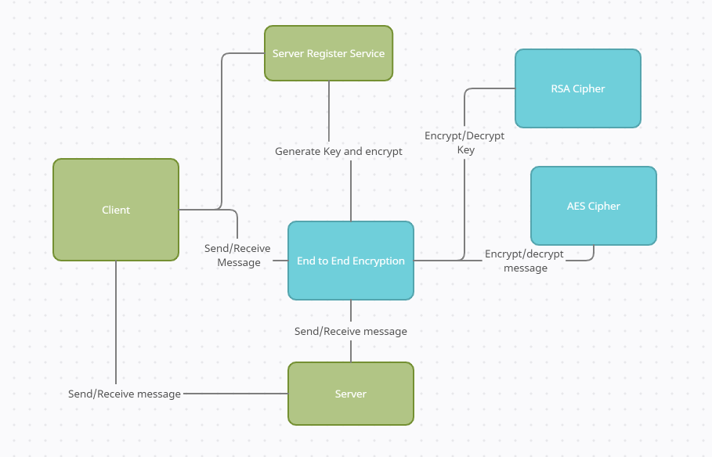
Application Framework

Slide 12
Q-5 Multi-tenant architecture with single instance of application layer which will have separate database for each client. Expected the architecture and approach document as output.
Technology Stack

Slide 13
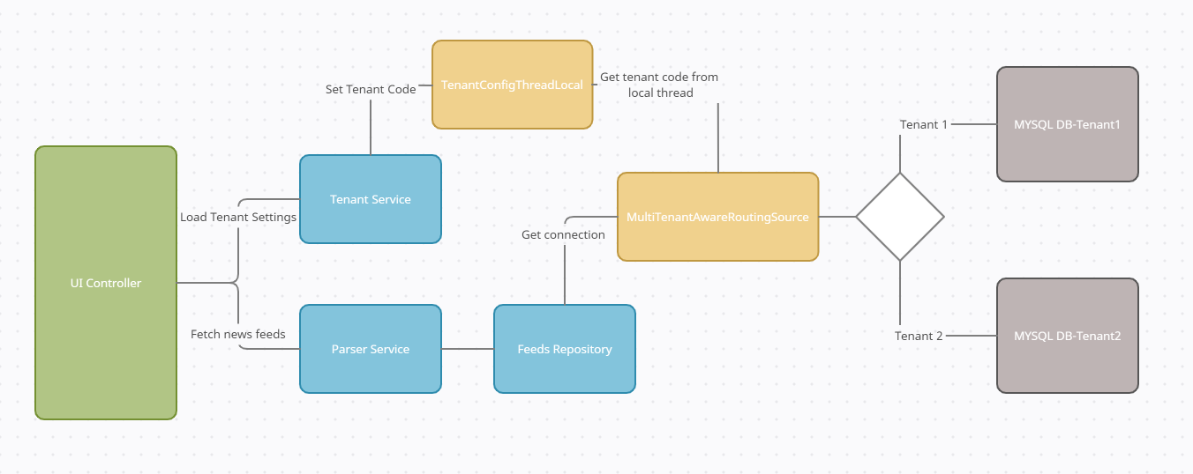
Application Framework

Slide 14
Q6 - Proof of Concept to demonstrate a Web application which has to use NoSQL platform as data storage, API based, Micro services and highly responsive UI which should support any size of screen ranging from large, medium and mobile browsers also should support all major web browsers. Application shall have different data types not limited to text, numbers, currency, file stream (docx, image, pdf, txt)
Technology Stack

Slide 15
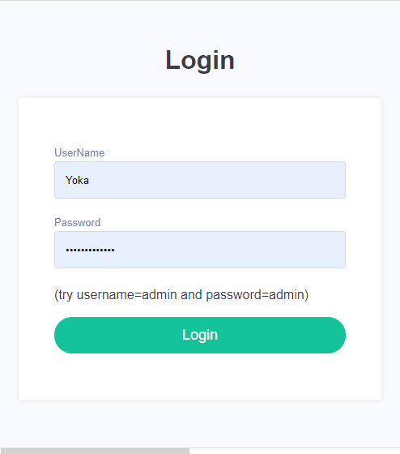
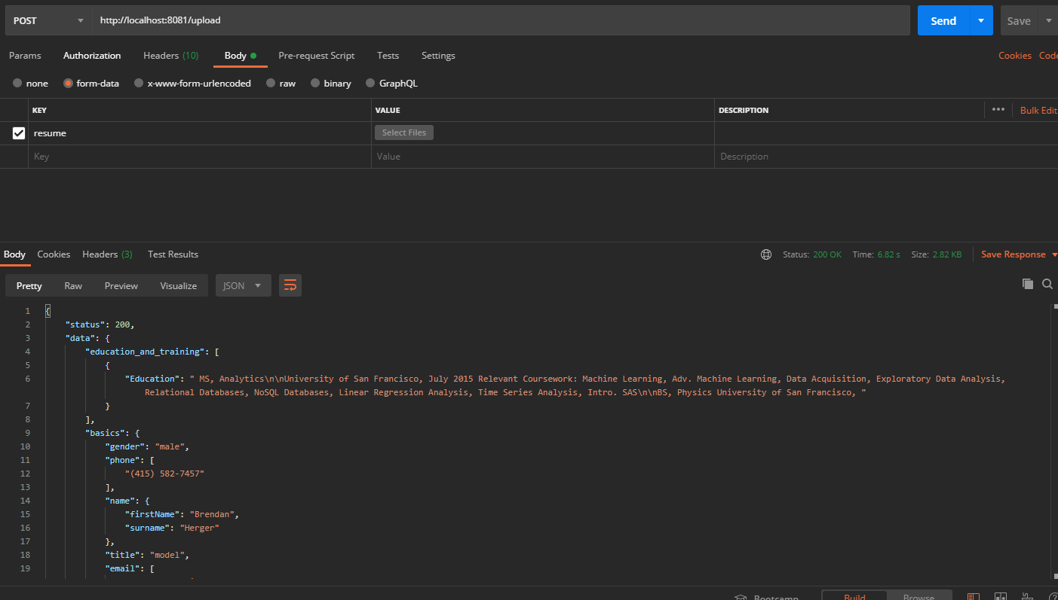
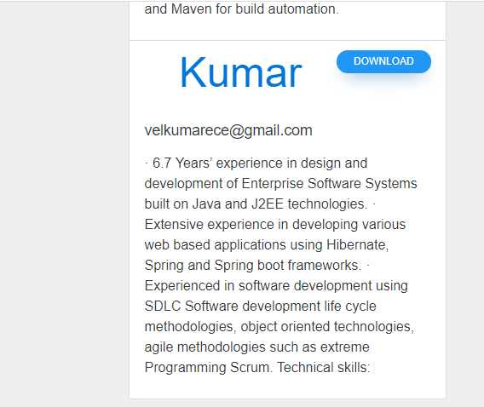
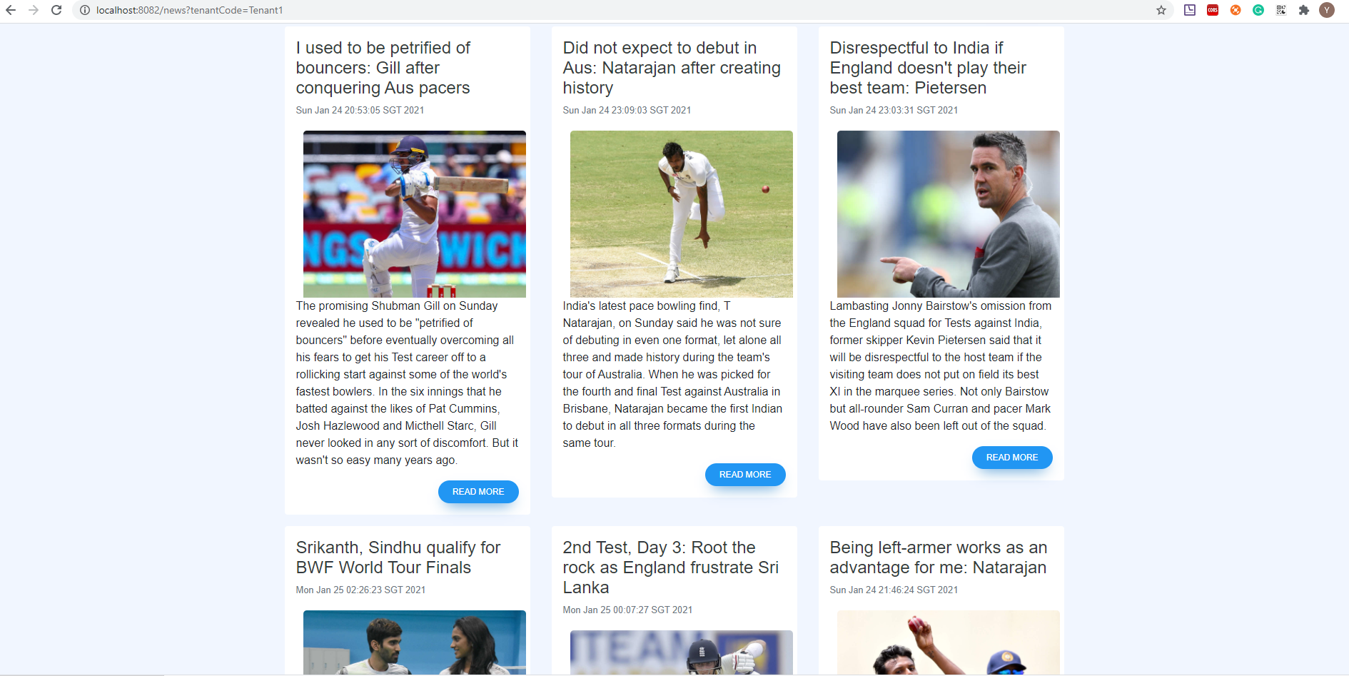
POC Screenshots

Slide 16

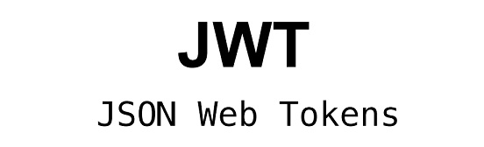
Q-7 Proof of Concept to demonstrate sharing session between different applications. Expectation is to have scalable session management where there is addition of new applications.
Technology Stack

Slide 17
Application Framework

Slide 18

Q-8 Proof of concept to demonstrate screen level field validations using regular expression. Expectation is to demonstrate, number, text, PAN, Passport currency, age, restricting special characters, restricting character range, restricting number range, restricting date range etc. solution shall be not limiting the mentioned sample validations.
Technology Stack

Slide 19
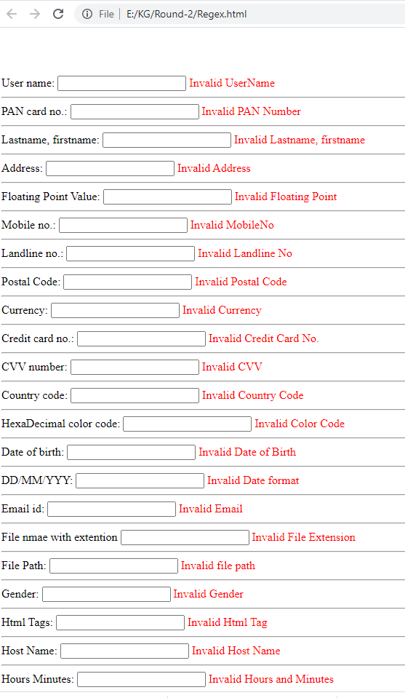
POC Screenshots

Slide 20
Thank you!

